Slide 1


Class: 5th Sem.
Course Code: HSS 461
Course Title: Accounts & Finance
Class Day: Friday Timing:
08:30am to 10:30am
11:30am to 01:30pm
Lecture / Week No. 8
Instructor Name: Asim Iqbal
BAHRIA UNIVERSITY
Computer & Software Engineering Department

Slide 2
Table Of Contents
S.R# | Contents | Page #
1. | Define accounting principles related to inventory | 6
2. | Define inventory costing methods | 9
3. | Account for perpetual inventory by the three most common costing methods | 15
4. | Compare the effects of the three most common costing methods | 34
5. | Apply the lower-of-cost-or market rule to inventory | 38
6. | Measure the effects of inventory errors | 42
7. | Estimate ending inventory by the gross profit method | 47
8. | Account for periodic inventory using the three most common costing methods | 52
9. | Reference | 77

Slide 3
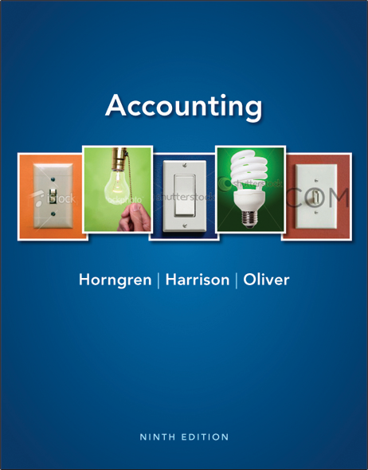
Merchandise Inventory
Chapter 6
Notes:
1
1
Chapter 6 will explain accounting for inventory.

Slide 4




Learning Objectives
 | Define accounting principles related to inventory
 | Define inventory costing methods
 | Account for perpetual inventory using the three most common costing methods
 | Compare the effects of the three most common inventory costing methods
Notes:
The objectives for this chapter include to:
1. Define accounting principles related to inventory.
2. Define inventory costing methods.
3. Account for perpetual inventory using the three most common costing methods.
4. Compare the effects of the three most common inventory costing methods.

Slide 5




Learning Objectives
 | Apply the lower-of-cost-or-market rule to inventory
 | Measure the effects of inventory errors
 | Estimate ending inventory by the gross profit method
 | Account for periodic inventory using the three most common costing methods (Appendix 6A)
Notes:
Additional objectives include to:
5. Apply the lower-of-cost-or-market rule to inventory.
6. Measure the effects of inventory errors.
7. Estimate ending inventory by the gross profit method.
8. Account for periodic inventory using the three most common costing methods (Appendix 6A).

Slide 6
Define accounting principles related to inventory

Slide 7
1
Define accounting principles related to inventory
Notes:
The first learning objective is to define accounting principles related to inventory.

Slide 8
Accounting Principles and Inventories
Accounting principles guide how we record transactions
Consistency
Same accounting methods from period to period
Disclosure
Report enough information for outsiders to make decisions
Materiality
Follow accounting rules for significant items
Conservatism
Exercise caution in financial reporting
Notes:
Several accounting principles affect inventories. Among them are consistency, disclosure, materiality, and accounting conservatism.
The consistency principle states that businesses should use the same accounting methods from period to period. Consistency helps investors compare a company’s financial statements from one period to the next. Companies must report any changes in the accounting methods they use. Investors need this information to make wise decisions about the company.
The disclosure principle holds that a company should report enough information for outsiders to make wise decisions about the company. In short, the company should report relevant, reliable, and comparable information about itself. This means disclosing the method being used to account for inventories.
The materiality concept states that a company must perform strictly proper accounting only for significant items. Information is significant when it would cause someone to change a decision. The materiality concept frees accountants from having to report every last item in strict accordance with GAAP.
Conservatism in accounting means exercising caution in reporting items in the financial statements. Conservatism says: 1.“Anticipate no gains, but provide for all probable losses.” 2. “If in doubt, record an asset at the lowest reasonable amount and a liability at the highest reasonable amount.” 3.“When there’s a question, record an expense rather than an asset.” The goal of conservatism is to report realistic figures.
The accounting principles are the foundations that guide how we record transactions.

Slide 9
S6-1: Inventory accounting principles
Davidson Hardware used the FIFO inventory method in 2012. Davidson plans to continue using the FIFO method in future years.
Requirement
1. Which inventory principle is most relevant to Davidson’s decision?
Consistency – using the same accounting methods from period to period
Notes:
Short Exercise 6-1 reviews the accounting principles that affect inventories.

Slide 10
Define inventory costing methods

Slide 11
2
Define inventory costing methods
Notes:
The second learning objective is to define inventory costing methods.

Slide 12
Inventory Costing Methods
Determining the cost of ending inventory for the balance sheet
Four Methods:
Specific-unit-cost
First-In, First-Out
Last-In,
First-Out
Average-cost
Notes:
There are four methods to cost inventory: (1) specific-unit-cost (2) First-In, First-Out (3) Last-In, First-Out, and (4) average-cost. A company can use any of these methods to account for its inventory.

Slide 13

Specific-Unit-Cost
Each inventory item has a specific cost
For businesses that sell unique, easily identified items
Examples: Cars, fine jewelry, real estate
Notes:
The specific-unit-cost method is also called the specific-identification method. This method uses the specific cost of each unit of inventory to determine Ending inventory and to determine Cost of goods sold. In the specific-unit-cost method, the company knows exactly which item was sold and exactly what the item cost. This costing method is best for businesses that sell unique, easily identified inventory items, such as automobiles (identified by the vehicle identification number [VIN]), jewels (a specific diamond ring), or real estate (identified by address).

Slide 14
First-In, First-Out (FIFO)
Assumes oldest items are sold first:
Oldest Costs
Cost of Goods Sold
Therefore, newest items are on hand:
Recent Costs
Ending Inventory
Notes:
Under the FIFO (First-In, First-Out) inventory costing method, the cost of goods sold is based on the oldest purchases—that is, the First In is the First Out of the warehouse (sold). Under the FIFO method, companies are assumed to sell their oldest inventory first.

Slide 15
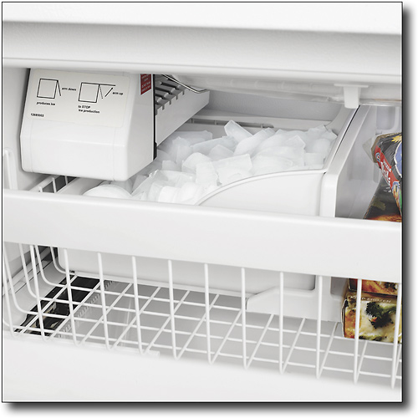
Last-In, First-Out (LIFO)
Assumes newest items are sold first:
Recent Costs
Cost of Goods Sold
Therefore, oldest items are on hand:
Oldest Costs
Ending Inventory
Notes:
LIFO is the opposite of FIFO. Under the LIFO (Last-In, First-Out) inventory costing method, ending inventory comes from the oldest costs (first purchases) of the period. The cost of goods sold is based on the most recent purchases (new costs)—that is, the Last In is the First Out of the warehouse (sold). Under the LIFO method, companies are assumed to sell their newest inventory first.

Slide 16
Average-Cost
The average-cost per unit is assigned to cost of goods sold and to units remaining in inventory.
A new average must be calculated with each purchase.
Cost of Inventory on Hand
Number of Units on Hand
Average Cost
÷
=
Notes:
Under the average-cost inventory costing method, the business computes a new average cost per unit after each purchase. Ending inventory and cost of goods sold are then based on the same average cost per unit. Under the average-cost method, an average price is calculated and applied to all goods.
Keep in mind the cost paid to purchase goods is the same under all inventory costing methods. The difference is where we divide up the dollars between the asset, Inventory, and the expense, COGS, on the income statement.

Slide 17
Account for perpetual inventory by the three most common costing methods

Slide 18
3
Account for perpetual inventory by the three most common costing methods
Notes:
The third learning objective is to account for perpetual inventory by the three most common costing methods–FIFO, LIFO, and weighted average.

Slide 19

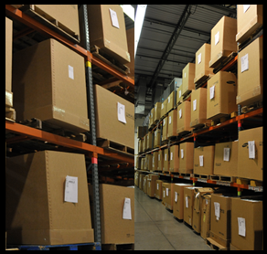

Inventory Accounting in a Perpetual System
The different inventory costing methods produce different amounts for:
ending inventory
cost of goods sold
Notes:
The different inventory costing methods produce different amounts for ending inventory and cost of goods sold, depending upon the method chosen.

Slide 20
First-In, First-Out (FIFO)
Beginning Inventory
Purchase 6 more at $45 each
 | Purchases |  |  | Cost of Goods Sold |  |  | Inventory on Hand
Date | Qty. | Unit Cost | Total Cost | Qty. | Unit Cost | Total Cost | Qty. | Unit Cost | Total Cost
Jul 1 |  |  |  |  |  |  | 2 | $40 | $80
5 6 $45 $270 2 40 80
6 45 270
Notes:
Under FIFO, the first costs incurred are the first costs assigned to cost of goods sold. FIFO leaves in ending inventory the last—the newest—costs.
Here is an example of FIFO:
The company began July with 2 DVDs that cost $40 each.
On July 5, the company purchases 6 more at $45 each.
Our ending inventory value contains 2 units at $40 each and 6 units at $45 each.

Slide 21
First-In, First-Out (FIFO)
On July 15 sold 4 units
 | Purchases |  |  | Cost of Goods Sold |  |  | Inventory on Hand
Date | Qty. | Unit Cost | Total Cost | Qty. | Unit Cost | Total Cost | Qty. | Unit Cost | Total Cost
Jul 1 |  |  |  |  |  |  | 2 | $40 | $80
5 6 $45 $270 2 40 80
6 45 270
15 2 $40 $80
2 45 90
4 45 180
Notes:
As the example continues, we see that on July 15, the company sold 4 units. Under FIFO, the first 2 units sold had the oldest cost ($40 per unit). The next 2 units sold cost $45 each. That leaves 4 units in inventory on July 15 at $45 each.

Slide 22
First-In, First-Out (FIFO)
On July 26 purchased 9 at $47
 | Purchases |  |  | Cost of Goods Sold |  |  | Inventory on Hand
Date | Qty. | Unit Cost | Total Cost | Qty. | Unit Cost | Total Cost | Qty. | Unit Cost | Total Cost
Jul 1 |  |  |  |  |  |  | 2 | $40 | $80
5 6 $45 $270 2 40 80
6 45 270
15 2 $40 $80
2 45 90
4 45 180
26 9 $47 $423 4 45 180
9 47 423
Notes:
On July 26, the company purchased 9 more DVD players for $47. That leaves 4 units in inventory on July 15 at $45 each and 9 units in inventory at $47 each, for a total inventory value of $603.

Slide 23
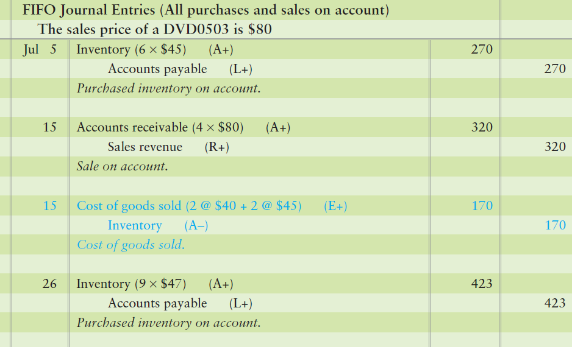
First-In, First-Out (FIFO)
Notes:
The journal entries to record the sale of the DVD Players would include the following :
For the purchase of 6 units at $45, Inventory is debited for the total cost of $270 and Accounts payable is credited for the total invoice amount of $270. For the sale, Accounts receivable is debited and Sales revenue is credited for $320 – the four DVD players multiplied by the $80 selling price.
The second entry is to record the cost of the players sold. The amount is determined using FIFO and is $170–2 players at $40 each plus 2 players at $45 each.
For the new purchase on July 26, debit Inventory for the total cost of $423–9 units at $47 each. Credit Accounts payable for the total invoice amount of $423.

Slide 24
Last-In, First-Out (LIFO)
Beginning Inventory
Purchase 6 more at $45 each
 | Purchases |  |  | Cost of Goods Sold |  |  | Inventory on Hand
Date | Qty. | Unit Cost | Total Cost | Qty. | Unit Cost | Total Cost | Qty. | Unit Cost | Total Cost
Jul 1 |  |  |  |  |  |  | 2 | $40 | $80
5 6 $45 $270 2 40 80
6 45 270
Notes:
Under LIFO, the newest purchase costs incurred are the first costs assigned to Cost of goods sold. LIFO leaves the oldest costs in Ending inventory.
Here is an example of LIFO:
The company began July with 2 DVDs that cost $40 each.
On July 5, the company purchases 6 more at $45 each.
Our ending inventory value contains 2 units at $40 each and 6 units at $45 each.

Slide 25
Last-In, First-Out (LIFO)
On July 15 sold 4 units
 | Purchases |  |  | Cost of Goods Sold |  |  | Inventory on Hand
Date | Qty. | Unit Cost | Total Cost | Qty. | Unit Cost | Total Cost | Qty. | Unit Cost | Total Cost
Jul 1 |  |  |  |  |  |  | 2 | $40 | $80
5 6 $45 $270 2 40 80
6 45 270
15 4 $45 $180
2 40 80
2 45 90
Notes:
As the process continues, we see that on July 15, the company sold 4 units. Under LIFO, the first 2 units sold had the oldest cost ($40 per unit). The next 2 units sold cost $45 each. That leaves 4 units in inventory on July 15–2 units at $40 each and 2 units at $45 each.

Slide 26
Last-In, First-Out (LIFO)
On July 26 purchased 9 at $47
 | Purchases |  |  | Cost of Goods Sold |  |  | Inventory on Hand
Date | Qty. | Unit Cost | Total Cost | Qty. | Unit Cost | Total Cost | Qty. | Unit Cost | Total Cost
Jul 1 |  |  |  |  |  |  | 2 | $40 | $80
5 6 $45 $270 2 40 80
6 45 270
15 4 $45 $180
2 40 80
2 45 90
26 9 $47 $423 2 40 80
2 45 90
9 47 423
Notes:
On July 26, the company purchased 9 more DVD players for $47. That leaves 2 units in inventory on July 15 at $40 each, 2 units at $45 each, and 9 units in inventory at $47 each–for a total inventory value of $593.

Slide 27
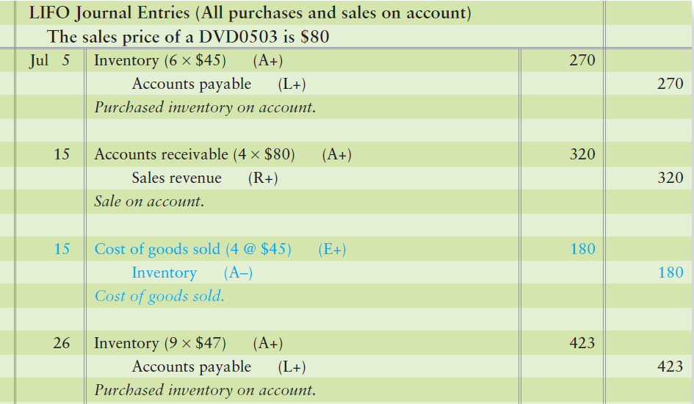
Last-In, First-Out (LIFO)
Notes:
The journal entries to record the sale of the DVD Players would include the following:
For the purchase of 6 units at $45, Inventory is debited for the total cost of $270 and Accounts payable is credited for the total invoice amount of $270. For the sale, Accounts receivable is debited and Sales revenue is credited for $320 – the four DVD players multiplied by the $80 selling price.
The second entry is to record the cost of the players sold. The amount is determined using LIFO and is $180, 4 players at $45 each.
For the new purchase on July 26, debit Inventory for the total cost of $423, 9 units at $47 each. Credit Accounts payable for the total invoice amount of $423.

Slide 28
Average-Cost Method
Beginning Inventory
Purchase 6 more at $45 each
 | Purchases |  |  | Cost of Goods Sold |  |  | Inventory on Hand
Date | Qty. | Unit Cost | Total Cost | Qty. | Unit Cost | Total Cost | Qty. | Unit Cost | Total Cost
Jul 1 |  |  |  |  |  |  | 2 | $40 | $80
5 6 $45 $270 8 43.75 350
Notes:
Here is an example of average cost method:
The company began July with 2 DVDs that cost $40 each.
On July 5, the company purchases 6 more at $45 each. Under weighted average, add the cost of the beginning inventory to the total cost of the purchase and divide by 8 to find the average values of each unit.
So: $80 + $270=$350.
$350 / 8 = $43.75 per unit

Slide 29
Average-Cost Method
On July 15 sold 4 units
 | Purchases |  |  | Cost of Goods Sold |  |  | Inventory on Hand
Date | Qty. | Unit Cost | Total Cost | Qty. | Unit Cost | Total Cost | Qty. | Unit Cost | Total Cost
Jul 1 |  |  |  |  |  |  | 2 | $40 | $80
5 6 $45 $270 8 43.75 350
15 4 $43.75 $175
4 43.75 175
Notes:
As the process continues, we find that on July 15, the company sold 4 units. Under the average-cost method, the 4 units sold had the average cost of $43.75 per unit. That leaves 4 units in inventory on July 15 at $43.75 each.

Slide 30
Average-Cost Method
On July 26 purchased 9 at $47
 | Purchases |  |  | Cost of Goods Sold |  |  | Inventory on Hand
Date | Qty. | Unit Cost | Total Cost | Qty. | Unit Cost | Total Cost | Qty. | Unit Cost | Total Cost
Jul 1 |  |  |  |  |  |  | 2 | $40 | $80
5 6 $45 $270 8 43.75 350
15 4 $43.75 $175
4 43.75 175
26 9 $47 $423 13 46.00 598
Notes:
On July 26, the company purchased 9 more DVD players for $47. That leaves 4 units in inventory on July 15 at $43.75 each and 9 units in inventory at $47 each–for a total inventory value of $598.

Slide 31
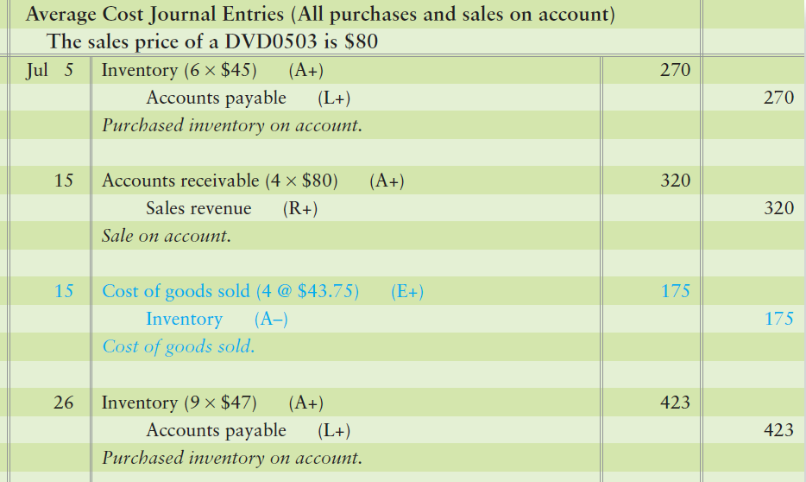
Average-Cost Method
Notes:
The journal entries to record the sale of the DVD Players would include the following :
For the purchase of 6 units at $45, Inventory is debited for the total cost of $270 and Accounts payable is credited for the total invoice amount of $270. For the sale, Accounts receivable is debited and Sales revenue is credited for $320–the four DVD players multiplied by the $80 selling price.
The second entry is to record the cost of the players sold. The amount is determined using average method and is $175, 4 players at $43.75 each.
For the new purchase on July 26, debit Inventory for the total cost of $423, 9 units at $47 each. Credit Accounts payable for the total invoice amount of $423.

Slide 32
E6-16: Inventory methods
Express Lane, Inc., a regional convenience store chain, maintains milk inventory by the gallon. The first month’s milk purchases and sales at its Freeport, FL, location follows:
Nov 2 | 1 gallon @ $2.00 each
6 | 2 gallons @ $2.10 each
13 | 2 gallons @ $2.20 each
14 | The store sold 4 gallons of milk to a customer.
Describe which costs would be sold and which costs would remain in inventory. Then, identify the amount that would be reported in inventory on November 15 using a. FIFO. b. LIFO. c. average cost.
Notes:
Exercise 6-16 reviews inventory methods.

Slide 33
E6-16 : Inventory methods
Describe which costs would be sold and which costs would remain in inventory.
 | FIFO | LIFO | Average Cost
Units sold include the:
Ending inventory includes the:
Average
costs of units
Oldest costs
Newest costs
Average
costs of units
Newest costs
Oldest costs
Notes:
The exercise continues on this slide.

Slide 34
Inventory Record: FIFO
Express Lane, Inc.
 |  | Purchases (Sold)
Date |  | Quantity | Unit Cost | Total Cost
Nov | 2 | 1 | $2.00 | $2.00
 | 6 | 2 | $2.10 | $4.20
Bal |  | 1 2 | $2.00 2.10 | $2.00 $4.20
 | 13 | 2 | $2.20 | $4.40
Bal. |  | 1 2 2 | $2.00 2.10 2.20 | $2.00 $4.20 $4.40
 | 14 | Sold (4) 1 2 1 | 2.00 2.10 2.20 | $2.00 4.20 2.20
Bal. |  | 1 | $2.20 | $2.20
Notes:
The exercise continues on this slide.

Slide 35
Inventory Record : LIFO
Express Lane, Inc.
 |  | Purchases (Sold)
Date |  | Quantity | Unit Cost | Total Cost
Nov | 2 | 1 | $2.00 | $2.00
 | 6 | 2 | $2.10 | $4.20
Bal |  | 1 2 | $2.00 2.10 | $2.00 $4.20
 | 13 | 2 | $2.20 | $4.40
Bal. |  | 1 2 2 | $2.00 2.10 2.20 | $2.00 $4.20 $4.40
 | 14 | Sold (4) 2 2 | 2.10 2.20 | $4.20 $2.20
Bal. |  | 1 | $2.00 | $2.00
End |  | 1 | $2.00 | $2.00
Notes:
The exercise continues on this slide.

Slide 36
Inventory Record : Average-Cost
Express Lane, Inc.
 |  | Purchases (Sold)
Date |  | Quantity | Unit Cost | Total Cost
Nov | 2 | 1 | $2.00 | $2.00
 | 6 | 2 | $2.10 | $4.20
Bal |  | 3 {2.00+4.20} / 3 | $2.0667 | $6.20
 | 13 | 2 | $2.20 | $4.40
Bal. |  | 5 {6.20+4.40} / 3 | $2.12 | $10.60
 | 14 | Sold (4) (4) | 2.12 | ($8.48)
Bal. |  | 1 | $2.12 | $2.12
End |  | 1 | $2.12 | $2.12
Notes:
The exercise continues.

Slide 37
Compare the effects of the three most common costing methods

Slide 38
4
Compare the effects of the three most common costing methods
Notes:
The fourth learning objective is to compare the effects of the three most common costing methods.

Slide 39
Use of Inventory Methods in Practice
Notes:
FIFO is the most popular inventory costing method; LIFO is the next most popular; and, Average cost ranks third.

Slide 40
Comparison
 | FIFO | LIFO | Average
Sales | $320 | $320 | $320
Cost of goods sold | $170 | $180 | $175
Gross profit | $150 | $140 | $145
Highest gross profit; highest net income
Lowest gross profit; lowest net income
If inventory prices are increasing
Notes:
This chart summarizes the results for the three inventory methods for the shirt example. It shows Sales revenue, Cost of goods sold, and Gross profit for FIFO, LIFO, and average-cost.
This shows that FIFO produces the lowest cost of goods sold and the highest gross profit. Net income is also the highest under FIFO when inventory costs are rising. Many companies prefer reporting high income in order to attract investors and borrow on good terms. FIFO offers this benefit, in a period of rising prices.
LIFO results in the highest cost of goods sold and the lowest gross profit. That lets companies pay the lowest income taxes when inventory costs are rising. Low tax payments conserve cash and that’s the main benefit of LIFO. The downside of LIFO is that the company reports low net income.
The average-cost method generates amounts that fall between the extremes of FIFO and LIFO. Companies that seek a “middle-ground” solution, therefore, use the average-cost method for inventory.

Slide 41
Advantage of Each Method
First-In,
First-Out
Last-In, First-Out
Average-
Cost
High income attracts investors
Lower income =
Less taxes
“Middle ground”
Notes:
Each inventory method offers advantages. In periods of rising prices, FIFO results in the highest net income, which attracts investors. LIFO results in the lowest net income and, thus, lower income taxes. The average-cost method provides a “middle ground” for companies.

Slide 42
Apply the lower-of-cost-or market rule to inventory

Slide 43
5
Apply the lower-of-cost-or market rule to inventory
Notes:
The fifth learning objective is to apply the lower-of-cost-or-market rule to inventory.

Slide 44
Lower-of-Cost-or-Market Rule
Example of conservatism
Inventory is reported at lower of:
Historical cost or
Market value (current replacement cost)
If market is lower than cost, write down inventory value
Notes:
In addition to the FIFO, LIFO, and average-cost methods, accountants face other inventory issues, such as the lower-of-cost-or-market rule, abbreviated LCM. LCM shows accounting conservatism in action and requires that inventory be reported in the financial statements at whichever is lower–the historical cost of the inventory or the market value of the inventory. For inventories, market value generally means current replacement cost (that is, the cost to replace the inventory on hand). If the replacement cost of inventory is less than its historical cost, the business must write down the inventory value. On the balance sheet, the business reports ending inventory at its LCM value. The entry to write down the inventory to LCM includes a debit to Cost of goods sold and a credit to Inventory.

Slide 45
P6-30A: Accounting principles for inventory and applying the lower-of-cost-or market rule Some of M and T Electronics’ merchandise is gathering dust. It is now December 31, 2012, and the current replacement cost of the ending inventory is $20,000–below the business’s cost of the goods, which was $100,000. Before any adjustments at the end of the period, the company’s Cost of goods sold account has a balance of $410,000. Requirements: 1. Journalize any required entries. 2. At what amount should the company report Inventory on the balance sheet? 3. At what amount should the company report Cost of goods sold? 4. Which accounting principle or concept is most relevant to this situation?
Notes:
Problem 6-28A demonstrates the lower-of-cost-or-market rule.

Slide 46
P6-30A: Accounting principles for inventory and applying the lower-of-cost-or market rule
Journalize any required entries.
At what amount should the company report for Inventory on the balance sheet?
At what amount should the company report for Cost of goods sold?
Which accounting principle or concept is most relevant to this situation?
Dec 12 | Cost of goods sold | 20,000
 | Inventory |  | 20,000
M and T should report inventory on the balance sheet at $80,000.
M and T should report Cost of goods sold on the Income Statement at $430,000.
Conservatism. The goal of conservatism is to report realistic figures.
Notes:
The problem continues on this slide.

Slide 47
6
Measure the effects of inventory errors
Notes:
The sixth learning objective is to measure the effects of inventory errors.

Slide 48
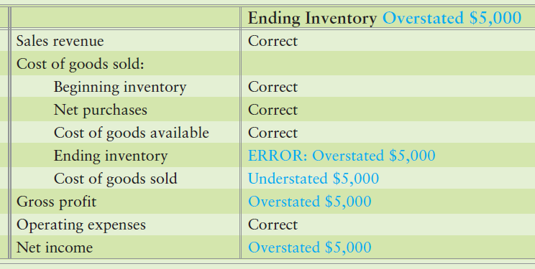
Inventory Errors : If Ending Inventory Overstated
Notes:
Businesses count their inventory at the end of the period. For the financial statements to be accurate, it’s important to get a correct count of ending inventory. An error in ending inventory creates a whole string of errors. To illustrate, suppose a company accidentally counted $5,000 more ending inventory than it actually had. In that case, ending inventory would be overstated by $5,000 on the balance sheet. This diagram shows how an overstatement of ending inventory affects cost of goods sold, gross profit, and net income.

Slide 49
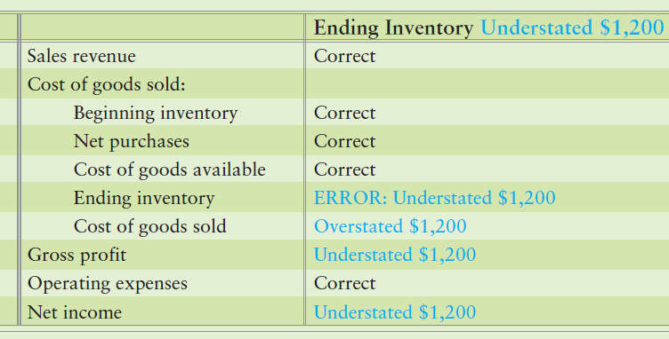
Inventory Errors: If Ending Inventory Understated
Notes:
Understating the ending inventory—reporting the inventory too low—has the opposite effect. Recall that one period’s ending inventory becomes the next period’s beginning inventory. As a result, an error in ending inventory carries over into the next period.

Slide 50
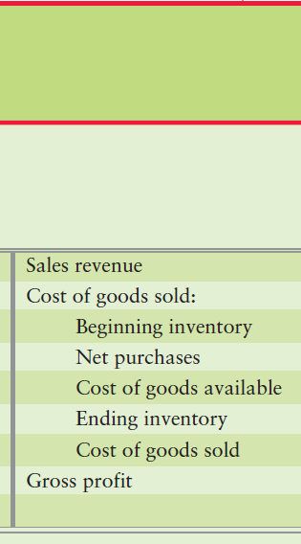
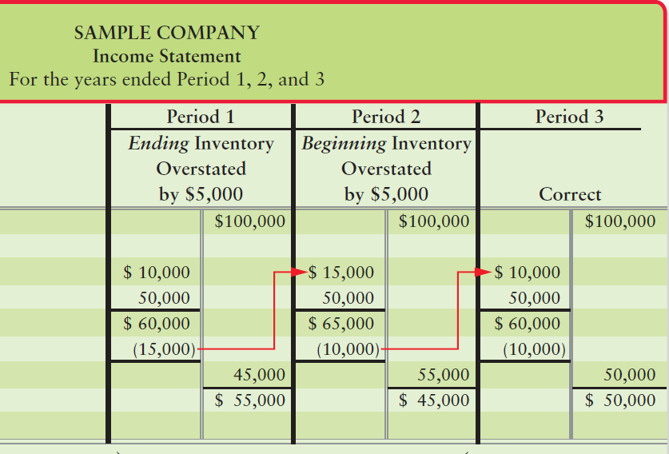
Inventory Errors: Multiple Periods
Notes:
Recall that one period’s ending inventory becomes the next period’s beginning inventory. As a result, an error in ending inventory carries over into the next period. Period 1’s ending inventory is overstated by $5,000; Period 1’s ending inventory should be $10,000. The error carries over to Period 2. Period 3 is correct. In fact, both Period 1 and Period 2 should look like Period 3.
Ending inventory is subtracted to compute cost of goods sold in one period. The same amount is added as beginning inventory in the next period. Therefore, an inventory error cancels out after two periods. The overstatement of cost of goods sold in Period 2 counterbalances the understatement for Period 1. So, total gross profit for the two periods combined is correct.

Slide 51
E6-26 Measuring the effect of an inventory error
Grandma Kate Bakery reported Sales revenue of $52,000 and Cost of goods sold of $22,000.
Compute Grandma Kate’s correct Gross profit if the company made either of the following independent accounting errors. Show your work.
Ending inventory is overstated by $6,000.
Ending inventory is understated by $6,000.
 |  | Inventory
 | As reported, incorrect | a. overstated by $6,000 | b. understated by $6,000
Sales Revenue | $ 52,000 | $ 52,000 | $ 52,000
Cost of goods sold | (22,000) | (28,000) | (16,000)
Gross Profit | $ 30,000 | $ 24,000 | $ 36,000
Notes:
Exercise 6-26 measures the effect of an inventory error.

Slide 52
7
Estimate ending inventory by the gross profit method
Notes:
The seventh learning objective is to estimate ending inventory by the gross profit method.

Slide 53
Gross Profit Method
Method to estimate ending inventory using the gross profit percent
Beginning inventory |  | $14,000
Net purchases |  | 66,000
Cost of goods available |  | 80,000
Estimated cost of goods sold:
Sales revenue | $100,000
Less: Estimated gross profit of 40% | (40,000)
Estimated cost of goods sold |  | (60,000)
Estimated cost of ending inventory |  | $20,000
Notes:
Often a business must estimate the value of its ending inventory. When this happens, the business will only have partial records showing its beginning inventory and records from vendors showing their net purchases.
Recall that Cost of goods available for sale is either deemed sold (COGS) or in Ending inventory. Since COGS plus Ending inventory equals Cost of goods available for sale, we can rearrange them as follows:
Beginning inventory
+ Net purchases
= Cost of goods available
– Cost of goods sold (Sales – Gross profit = COGS)
= Ending inventory
Suppose a company suffers a natural catastrophe and all its inventory is destroyed. To collect insurance, the company must estimate the cost of the inventory destroyed. Using its normal gross profit percent (that is, gross profit divided by net sales revenue), a company can estimate cost of goods sold. Then it needs to subtract cost of goods sold from goods available to estimate ending inventory.

Slide 54
S6-14 : Estimating ending inventory by the gross profit method Glass Company began the year with inventory of $42,450 and purchased $263,000 of goods during the year. Sales for the year are $501,000, and Glass’s gross profit percentage is 55% of sales. Requirement: 1. Compute the estimated cost of ending inventory by the gross profit method.
Notes:
Exercise 6-27 provides practice on using the gross profit method to estimate ending inventory. New Life’s beginning inventory and net purchases are added together to determine the cost of goods available. Then, the company’s sales revenue is multiplied by the gross profit percentage. This is subtracted from net sales to determine estimated cost of goods sold. The estimated cost of goods sold is subtracted from the cost of goods available to provide an estimate of ending inventory.

Slide 55
S6-14 : Estimating ending inventory by the gross profit method
To compute the estimated cost of ending inventory by the gross profit method:
Beginning inventory………………………. |  | $42,450
Purchases…………………………………... |  | 263,000
Cost of goods available………………….. |  | 305,450
Cost of goods sold:
Sales revenue……………………………. | $501,000
Less: Estimated gross profit of 55%… | (275,550)
Estimated cost of goods sold…………. |  | (225,450)
Estimated cost of ending inventory…….. |  | $ 80,000
Notes:
Short Exercise 6-14 continues on this slide.

Slide 56
Ethical Issues
Financial downturn; profits down
Temptation to make financials look better
“Cook the books”
Methods:
Overstate ending inventory
Lowers cost of goods sold
Increasing profits
Create fictitious sales
Cost of goods sold remains the same
Increasing profits
Notes:
No area of accounting has a deeper ethical dimension than inventory. Companies whose profits are lagging can be tempted to “cook the books.” An increase in reported income will make the business look more successful than it really is. There are two main schemes for cooking the books. The easiest way is to overstate ending inventory. The second way to cook the books involves sales. By increasing sales without having a corresponding cost of goods sold, the profits were overstated.

Slide 57
8
Account for periodic inventory using the three
most common costing methods (Appendix 6A)
Notes:
The seventh learning objective is to estimate ending inventory by the gross profit method.

Slide 58
Inventory in a Periodic System
Simpler
No running record of inventory
Inventory counted at end of a period.
Better for small businesses with smaller inventory amounts
Adds four new accounts:
Purchases
Purchase discounts
Purchase returns and allowances
Freight in
Notes:
Accounting is simpler in a periodic system because the company keeps no daily running record of inventory on hand. The only way to determine the ending inventory and cost of goods sold in a periodic system is to count the goods—usually at the end of the year. The periodic system works well for a small business in which the inventory can be controlled by visual inspection—that is, the inventory usually is not large in size or dollar amount. The periodic system uses four additional accounts–Purchases, Purchase discounts, Purchase returns and allowances and Freight in.

Slide 59
Four New Accounts
Purchases—Holds the cost of inventory as it is purchased (Debit balance)
Purchase discounts—Discounts for early payment of purchases (Credit balance)
Purchase returns and allowances—Items purchased, but returned to the vendor or allowances granted (Credit balance)
Freight in—holds the transportation cost paid on inventory purchases (Debit balance)
Notes:
Purchases—This account holds the cost of inventory as it is purchased. Purchases carries a debit balance and is an expense account.
Purchase discounts—This contra account carries a credit balance. Discounts for early payment of purchases are recorded here.
Purchase returns and allowances—This contra account carries a credit balance. Items purchased, but returned to the vendor are recorded in this account. Allowances granted by a vendor are also recorded in this account.
Freight in—This account holds the transportation cost paid on inventory purchases. It carries a debit balance and is an expense account.
In the perpetual system, all of these costs go into the Inventory account.

Slide 60

Cost of Goods Sold Computed by Formula
Purchases
- Purchase Discounts
- Purchase returns and allowances
+ Freight In
= Net Purchases
Beginning inventory
+ Net purchases
Cost of goods available
– Ending inventory
Cost of goods sold
Notes:
The Cost of good sold is determined as follows:
Beginning inventory is the ending inventory from the preceding period
Add Net purchases, often abbreviated as Purchases
Equals Cost of goods available for sale
Minus Ending inventory on hand at the end of the current period
Equals Cost of goods sold

Slide 61
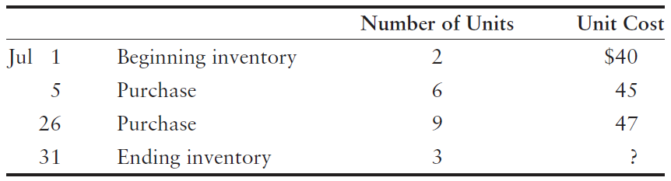
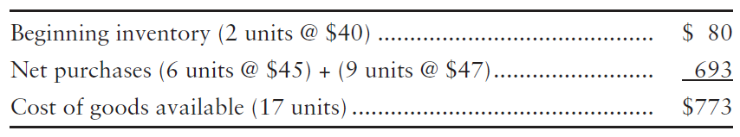
FIFO, LIFO, and Average-Cost
Same pattern as perpetual
Notes:
The various inventory costing methods (FIFO, LIFO, and average-cost) in a periodic inventory system follow the pattern illustrated earlier for the perpetual system. For all three inventory costing methods, cost of goods available is always the sum of beginning inventory plus net purchases.
The different methods—FIFO, LIFO, and average-cost—compute different amounts for ending inventory and cost of goods sold. In other words, the $773 invested in cost of goods available for sale will be either on the balance sheet in Inventory, or expensed on the income statement in Cost of goods sold.

Slide 62
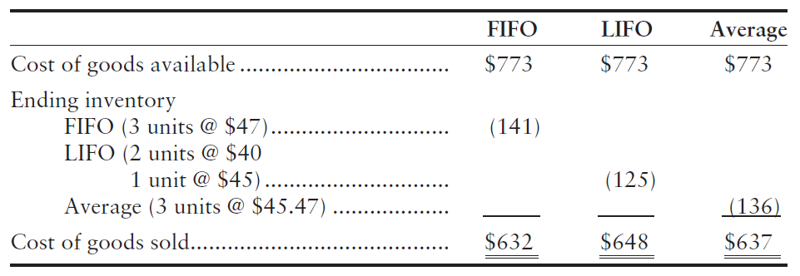
FIFO, LIFO, and Average-Cost under Periodic Method
Notes:
Under FIFO, the ending inventory comes from the newest—the most recent—purchases.
Periodic and perpetual are always the same for FIFO because FIFO sells oldest inventory acquisitions first. Therefore, it does not matter when FIFO is calculated; the first purchase will always be the same whether we calculate cost of goods sold on the sale date (perpetual) or at the end of the period (periodic).
Under LIFO, the ending inventory comes from the oldest cost of the period—in this case, the beginning inventory of two units that cost $40 per unit, plus the first purchase at $45.
In the average-cost method, we compute a single average cost per unit for the entire period. $773 divided by 17 units equals $45.47. Then, we apply this average cost to compute ending inventory and cost of goods sold.

Slide 63
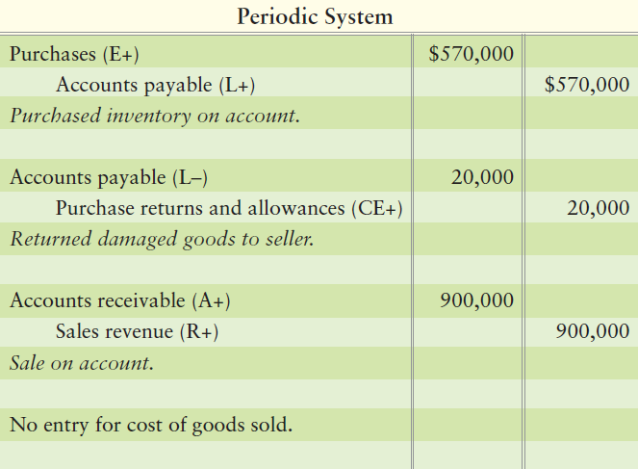
Periodic Method Journal Entries
Notes:
Purchases are debited for inventory purchased during the period. Accounts payable would be credited. When returns are made, we debit Accounts payable and credit Purchase returns and allowance. This will accumulate all returns or allowances granted in one account.
If the invoice is paid within a discount period, a credit to the Purchase discount account would be made at the times of payment. This is similar to Sales discounts, but rests on the company books of the buying company.

Slide 64
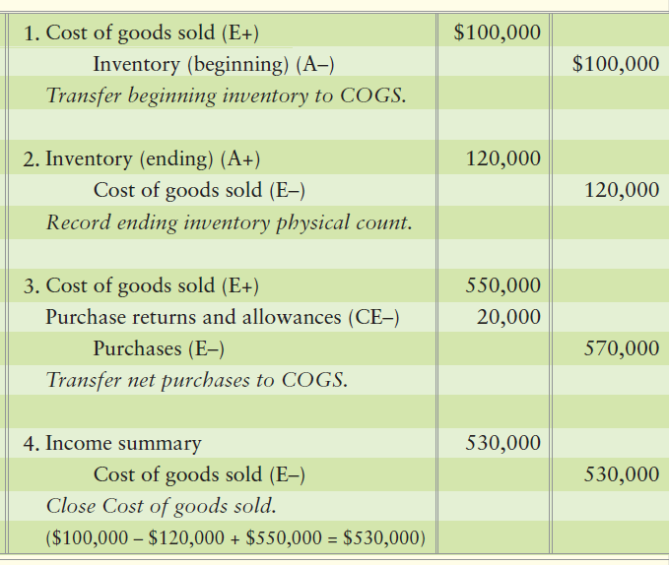
Closing Entries
The four new accounts would be closed out at period end.
Notes:
The four new accounts would be closed out at period end.

Slide 65
E6A-1 Computing periodic inventory amounts
The periodic inventory records of Synergy Prosthetics indicate the following at July 31:
At July 31, Synergy counts two units of inventory on hand.
1. Compute ending inventory and cost of goods sold, using each of the following methods:
a. Average-cost (round average unit cost to nearest cent)
b. First-In, First-Out
c. Last-In, First-Out
Jul 1 | Beginning inventory | 6 units @ $60
8 | Purchase | 5 units @ $67
15 | Purchase | 10 units @ $70
26 | Purchase | 5 units @ $85
Notes:
Exercise 6A-1 reviews how to compute inventory amounts.

Slide 66
E6A-1 Computing periodic inventory amounts
Jul 1 | Beginning inventory | 6 units @ $60 = | $ 360
8 | Purchase | 5 units @ $67 | 335
15 | Purchase | 10 units @ $70 | 700
26 | Purchase | 5 units @ $85 | 425
 | Goods available | 26 units | $1,820
 |  |  | Ending inventory |  |  |  | Cost of goods sold
1. | Average |  | $1,820÷ 26 units =average
 |  |  | unit cost of $70 × 2 | = | $140 |  | $1,820 − $140 | = | $1,680
2. | FIFO |  | 2 @ $85 | = | $170 |  | $1,820 − $170 | = | $1,650
3. | LIFO |  | 2 @ $60 | = | $120 |  | $1,820 − $120 | = | $1,700
Notes:
The exercise continues on this slide.

Slide 67
Chapter 6 Summary
The accounting principles are the foundations that guide how we record transactions.
Inventory costing methods include specific-unit-cost, FIFO, LIFO, and average cost.
Specific unit identifies the specific cost of each unit of inventory that is in ending inventory and each item that is in cost of goods sold.
Under FIFO, the cost of goods sold is based on the oldest purchases.
Notes:
The accounting principles are the foundations that guide how we record transactions.
Inventory costing methods include specific-unit-cost, FIFO, LIFO, and average cost. Specific-unit-cost identifies the specific cost of each unit of inventory that is in ending inventory and each item that is in cost of goods sold. Under FIFO, the cost of goods sold is based on the oldest purchases.

Slide 68
Chapter 6 Summary
Under LIFO, the cost of goods sold is based on the newest purchases.
Under the average-cost method, the business computes a new average cost per unit after each purchase. Keep in mind the cost paid to purchase goods is the same under all inventory costing methods. The difference is where we divide up the dollars between the asset, Inventory, and the expense, COGS, on the income statement.
Notes:
Under LIFO, the cost of goods sold is based on the newest purchases. Under the average-cost method, the business computes a new average cost per unit after each purchase. Keep in mind the cost paid to purchase goods is the same under all inventory costing methods. The difference is where we divide up the dollars between the asset, Inventory, and the expense, COGS, on the income statement.

Slide 69
Chapter 6 Summary
The inventory costing method dictates which purchases are deemed sold (COGS). The sales price to the customer (Sales revenue) is the same regardless of which costing method is used to record COGS. Only the amounts in the COGS journal entries differ among the three costing methods.
If the cost of inventory is declining, an adjustment must be made to lower the Inventory account to the lower value (market). If market is greater than cost, no adjustment is made to the Inventory account.
Notes:
The inventory costing method dictates which purchases are deemed sold (COGS). The sales price to the customer (Sales revenue) is the same regardless of which costing method is used to record COGS. Only the amounts in the COGS journal entries differ among the three costing methods.
If the cost of inventory is declining, an adjustment must be made to lower the Inventory account to the lower value (market). If market is greater than cost, no adjustment is made to the Inventory account.

Slide 70
Chapter 6 Summary
Because the total spent to acquire goods available for sale is allocated to only the Inventory or the COGS account, if Inventory is incorrectly stated due to an error, COGS is also incorrectly stated. When discovered, errors must be disclosed and corrected in the affected financial statements.
Notes:
Because the total spent to acquire goods available for sale is allocated to only the Inventory or the COGS account, if Inventory is incorrectly stated due to an error, COGS is also incorrectly stated. When discovered, errors must be disclosed and corrected in the affected financial statements.

Slide 71
Chapter 6 Summary
Account for periodic inventory using the three most common costing methods (Appendix 6A)
Accounting is simpler in a periodic system because the company keeps no daily running record of inventory on hand. The only way to determine the ending inventory and cost of goods sold in a periodic system is to count the goods—usually at the end of the year.
Notes:
Accounting for periodic inventory using the three most common costing methods (Appendix 6A). Accounting is simpler in a periodic system because the company keeps no daily running record of inventory on hand. The only way to determine the ending inventory and cost of goods sold in a periodic system is to count the goods—usually at the end of the year.

Slide 72
Chapter 6 Summary
The periodic system uses four additional accounts:
Purchases—this account holds the cost of inventory as it is purchased. Purchases carries a debit balance and is an expense account.
Purchase discounts—this contra account carries a credit balance. Discounts for early payment of purchases are recorded here.
Purchase returns and allowances—this contra account carries a credit balance. Items purchased but returned to the vendor are recorded in this account. Allowances granted by a vendor are also recorded in this account.
Notes:
The periodic system uses four additional accounts:
Purchases—This account holds the cost of inventory as it is purchased. Purchases carries a debit balance and is an expense account.
Purchase discounts—This contra account carries a credit balance. Discounts for early payment of purchases are recorded here.
Purchase returns and allowances—This contra account carries a credit balance. Items purchased but returned to the vendor are recorded in this account. Allowances granted by a vendor are also recorded in this account.

Slide 73
Chapter 6 Summary
Freight in—this account holds the transportation cost paid on inventory purchases. It carries a debit balance and is an expense account.
The end-of-period entries are more extensive in the periodic system because we must close out the beginning inventory balance and set up the cost of the ending inventory. This appendix illustrates the closing process for the periodic system.
Notes:
Freight in—this account holds the transportation cost paid on inventory purchases. It carries a debit balance and is an expense account.
The end-of-period entries are more extensive in the periodic system because we must close out the beginning inventory balance and set up the cost of the ending inventory. The appendix illustrates the closing process for the periodic system.

Slide 74
Chapter 6 Summary
Cost of goods sold in a periodic system is computed by the following formula (using assumed amounts for this illustration):
Beginning inventory
+ Net purchases
= Cost of goods available
Ending inventory
= Cost of goods sold
Net purchases is determined as follows:
Purchases
- Purchase discounts
- Purchase returns and allowances
+ Freight in
= Net purchases
Notes:
Cost of goods sold in a periodic system is computed by the following formula (using assumed amounts for this illustration):
Beginning inventory
+ Net purchases
= Cost of goods available
Ending inventory
= Cost of goods sold
Net purchases is determined as follows:
Purchases
- Purchase discounts
- Purchase returns and allowances
+ Freight in
= Net purchases

Slide 75

Notes:
Do you have any questions?

Slide 76

Copyright
All rights reserved. No part of this publication may be reproduced, stored in a retrieval system, or transmitted, in any form or by any means, electronic, mechanical, photocopying, recording, or otherwise, without the prior written permission of the publisher. Printed in the United States of America.

Slide 77
.
References / Resources
https://www.investopedia.com/terms/i/inventoryaccounting.asp
https://www.principlesofaccounting.com/chapter-8/inventory-costing-methods/
https://www.accountingformanagement.org/perpetual-inventory-system/
https://courses.lumenlearning.com/finaccounting/chapter/effects-of-inventory-method-on-the-financial-statement/
https://www.accountingtools.com/articles/2017/5/13/lower-of-cost-or-market-lcm
https://yourbusiness.azcentral.com/determine-effects-inventory-errors-calculate-inventory-turnover-25787.html
https://www.accountingtools.com/articles/2017/5/13/gross-profit-method
https://www.accountingformanagement.org/periodic-inventory-system/

